Slide 1

SPCrowd team is happy to present an idea of
ECOMIND
Change your attitude for better tomorrow

Slide 2

USER JOURNEY… HOW CAN WE HELP?
This is Mike. He would love to keep awareness and be more eco-friendly, but he does not know how, where and what to recycle.
For example, not all types of plastic in Belarus could be recycled.
Our app will instantly recognize the type of waste, whether it is recyclable in our country, and provide all other necessary information for Mike.

Slide 3
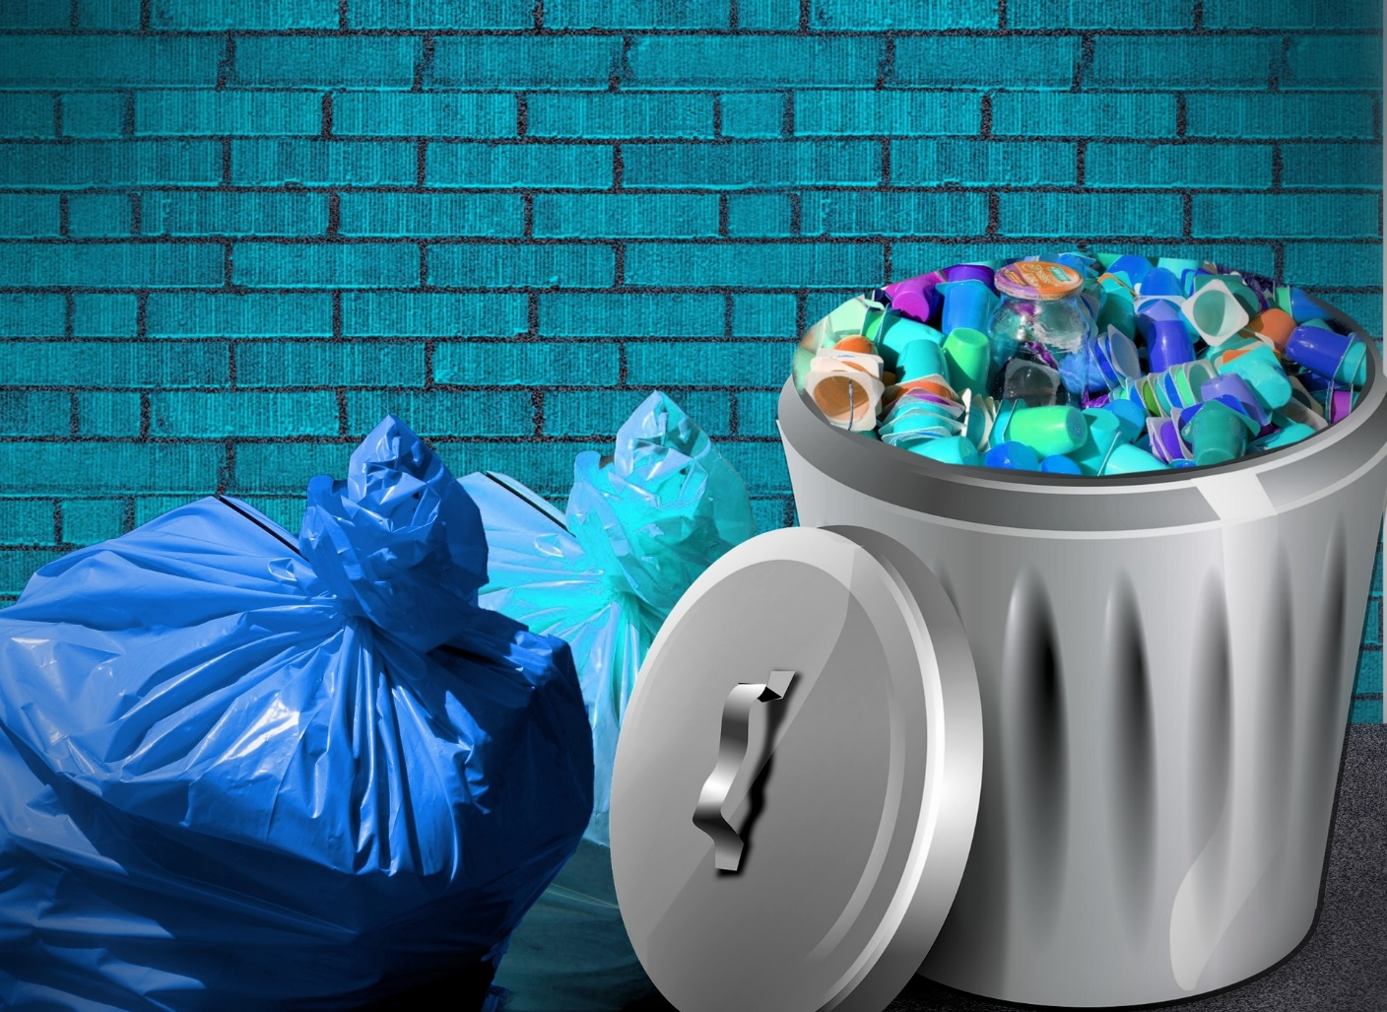
OUR GOAL
is to make recycling a usual thing.
The main CHALLENGE that needs to be addressed
is people's inertia in Belarus to recycle.

Slide 4
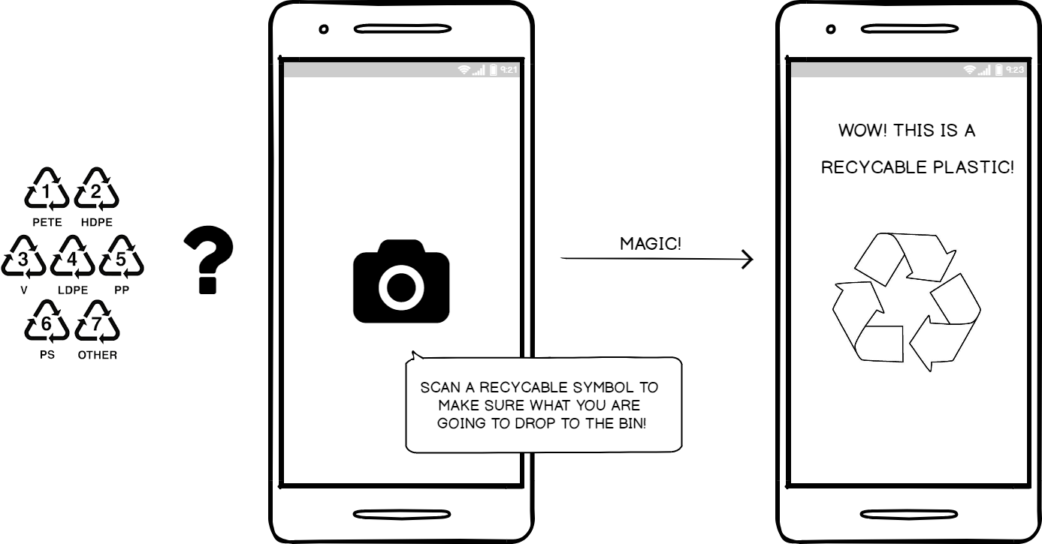
ECOMIND – is an eco-mindful app
Recyclable symbol scanning & recognition
Instant classifying and assisting you with recycling
SPCrowd Team

Slide 5
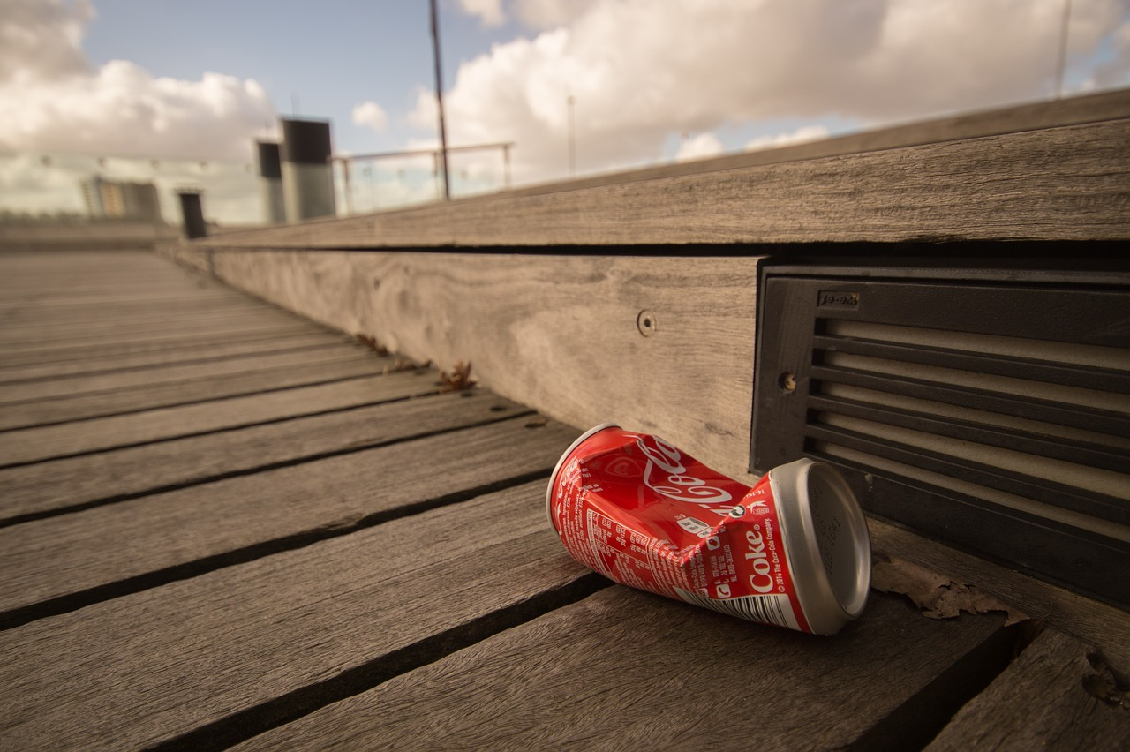
ADDITIONAL FEATURES
Eco information in your local area
Maps with eco points to recycle
Gamification and rating for authorized users

Slide 6
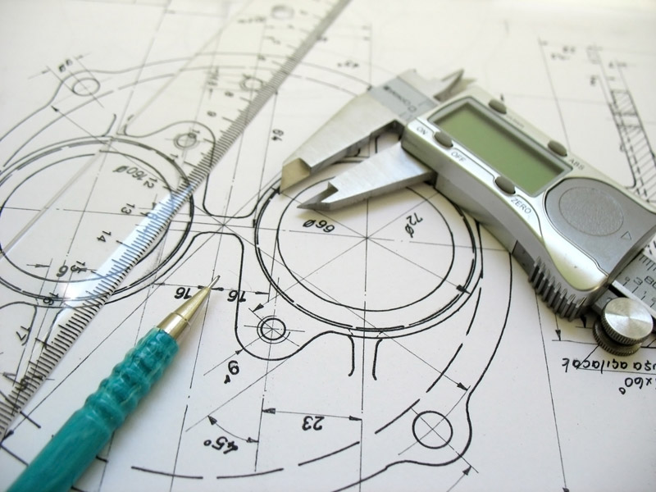
Technical Side
Mobile App
Machine Learning model
Research over best algorithms
Google Vision API
Python
Flask framework

Slide 7

Roadmap
Train model on larger data set
Enhance classifier for all types of recyclable waste
Add GO-GREEN information and advices within the app

Slide 8

WE THINK BIG…
Cooperate with EPAM GARAGE to develop Stand-alone scanner device
Highly customizable app could be adjusted to recycle in other countries with specific eco symbols knowledge base

Slide 9

Still have questions? We prepared Q&A for you!
Q: What's the point of knowing what type of plastic I scanned?
A: It will not only show you the type of waste, but also your local rules how you can help to recycle it.
Q: Can it be used in EPAM?
A: Surely, as a company EPAM takes high attention to the
environment and supports the idea of waste recycling. The standalone scanner app could be used in each EPAM office to help people to identify which recycle bin to use.
Q: How can it be monetized?
A: Eco-friendly goods and services advertisement, recycling companies support (stand-alone scanner).

Slide 10
Thanks for watching!
SPCrowd Team

